Slide 1
Conflict-free Replicated Data Types
by Marc Shapiro, Nuno Preguiça, Carlos Baquero, Marek Zawirski
Presented By
Aman Sachan, Mukul Sharma, Ashish Shashikant Bokil, Mahabir Sibamprasad Senapati, Shashank Singh, Chithra Sivan Kuthiramooli, Nikita Yadav, Tanmay Yogesh Sule, Showkat Ali, Ashish Sanjay Kankal

Slide 2
Motivation
WHY
WHAT
HOW
Why a new data type ?
What are the issues with existing system ?
How it addresses the issues ?

Slide 3
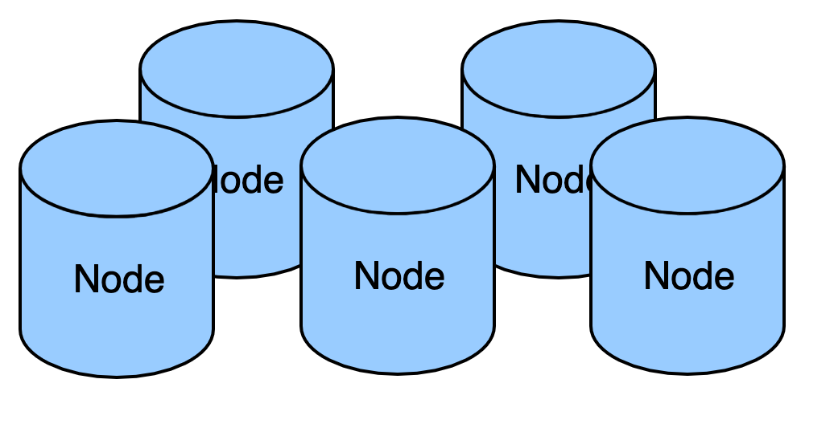
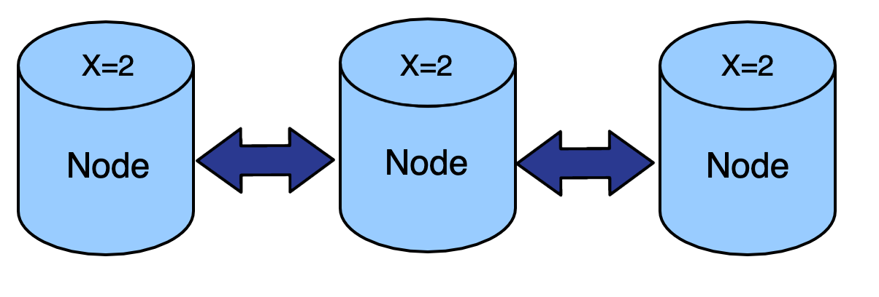
Distributed System
Essential Features of any Large Distributed System
(WWW, peer-to-peer or cloud computing platforms)
Replication
Consistency

Slide 4
Strong Consistency
Strong consistency protocol serializes the updates in Global Total Order
Immediate Propagation of updates across nodes
Bottleneck with availability and partition tolerance.
Weaker consistency is acceptable in some class of applications

Slide 5
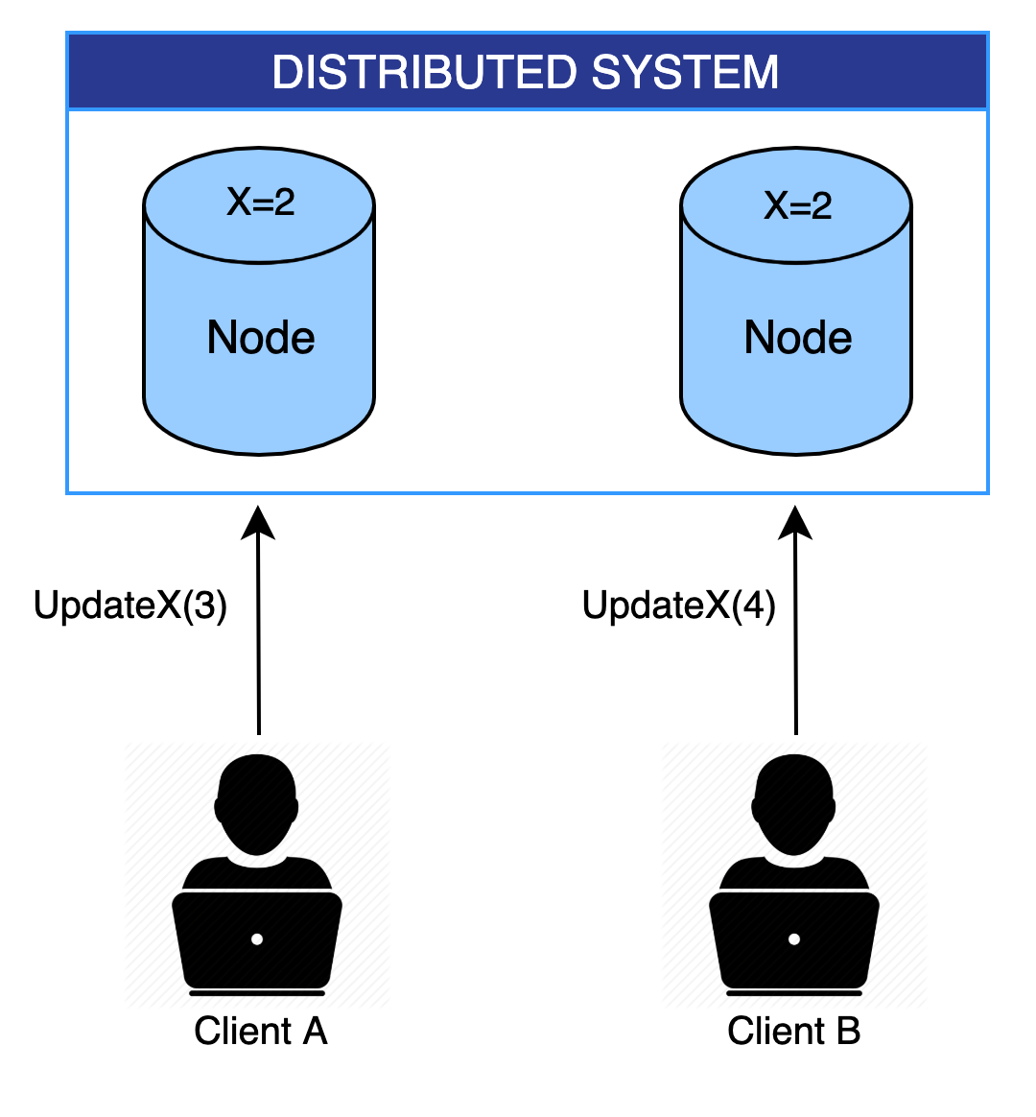
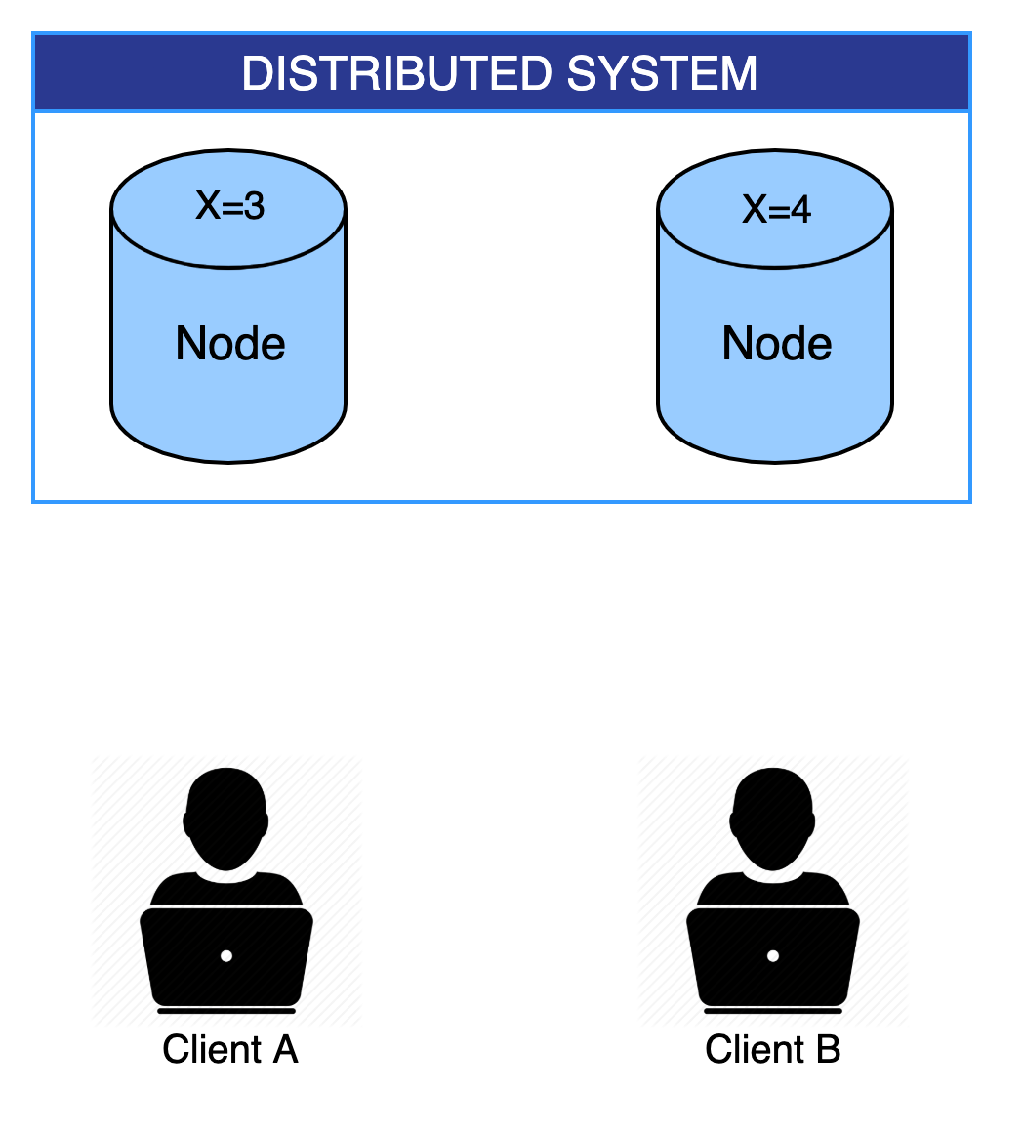
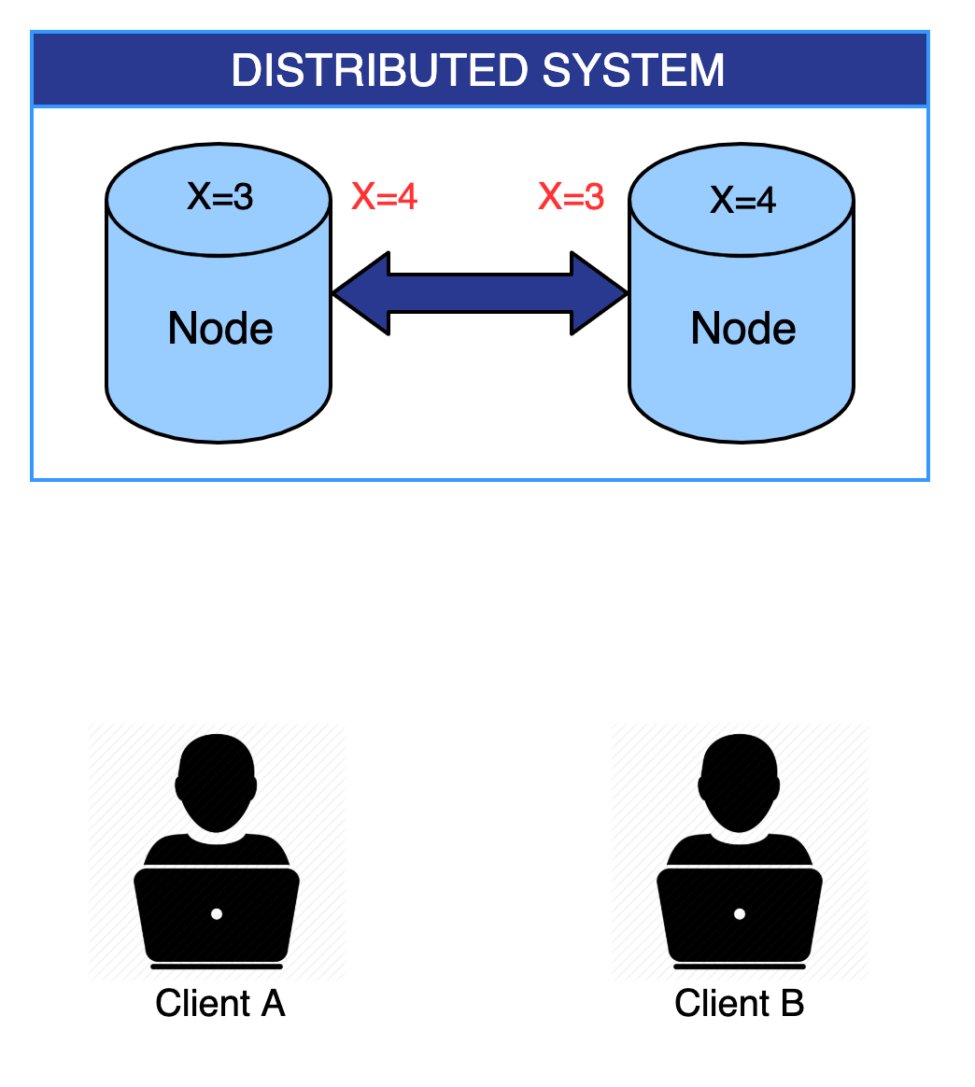
Conflicts
A state of the system, in which the node or replica generate and store different versions of data locally and when they try to converge, it causes a conflict.

Slide 6

Conflict Resolution is very hard
Requires Background Consensus Algorithm
Literature offers less guidance
Can Lead to permanent inconsistency

Slide 7
How to deal with the problem ?

Slide 8
CRDT Conflict-Free Replicated Data types
Leverages some mathematical semantics which ensures there are no conflicts
- Does not require Conflict Resolution
- No Consensus
- No Synchronization among nodes
Still CONVERGE !!!

Slide 9
RECALL
CAP THEOREM
STRONG CONSISTENCY (C)
AVAILABILITY (A)
PARTITION TOLERANCE (P)
It is impossible to simultaneously ensure strong consistency, availability and tolerate network partition.
As network faults are unavoidable, so real system need to compromise either consistency or availability.
Does this mean, Consistency is always compromised
to ensure Availability ?

Slide 10
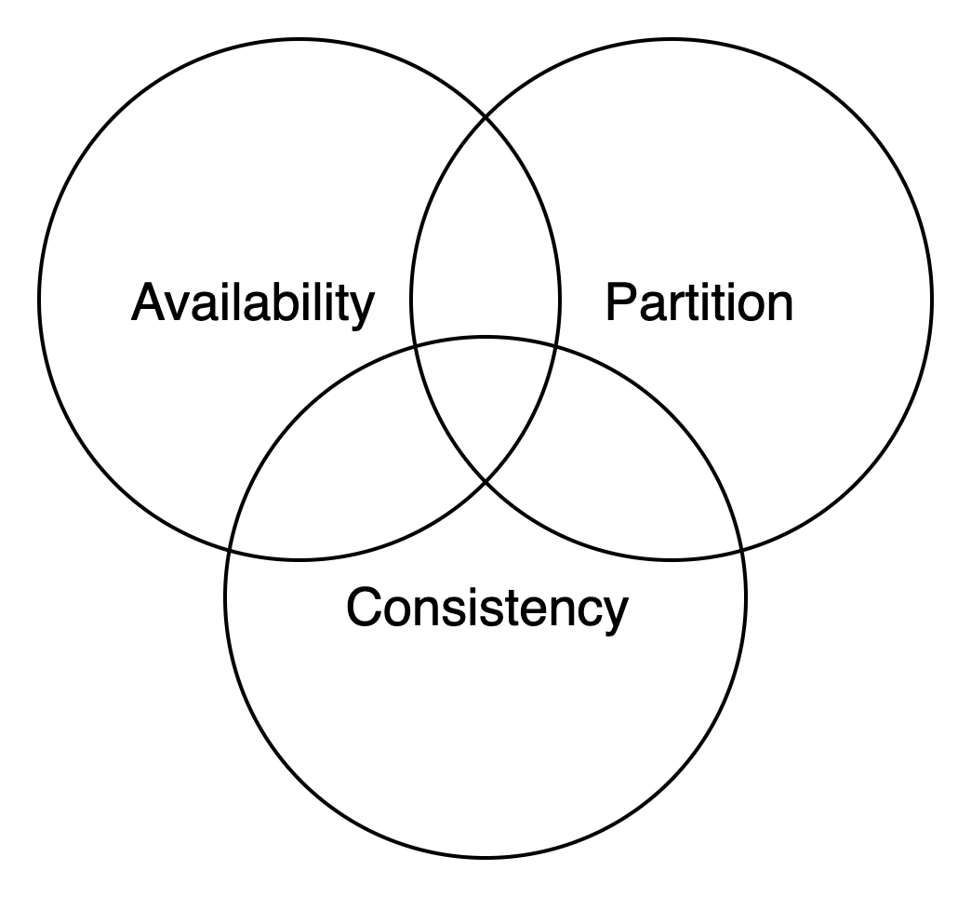
CAP Theorem and CRDT
CRDT uses Strong Eventual Consistency(SEC)
SEC (Partial Order) is weaker than Strong Consistency (Global Total Order)
but provides the well-defined guarantee of strong eventual convergence.
Fault Tolerance
SEC provides extreme form of Fault Tolerance
SEC Object i.e. CRDT can tolerate upto n -1 simultaneous crashes
Recall : CRDT doesn’t require consensus

Slide 11
SYSTEM MODEL AND REPLICATIONS

Slide 12

System Model
System of a finite set of non-byzantine processes interconnected by an asynchronous network.
Processes in may crash silently; a crashed process may recover with its memory intact.
These processes share replica of an object of concern.
Network can partition and recover.
A non-crashed process is said correct.

Slide 13
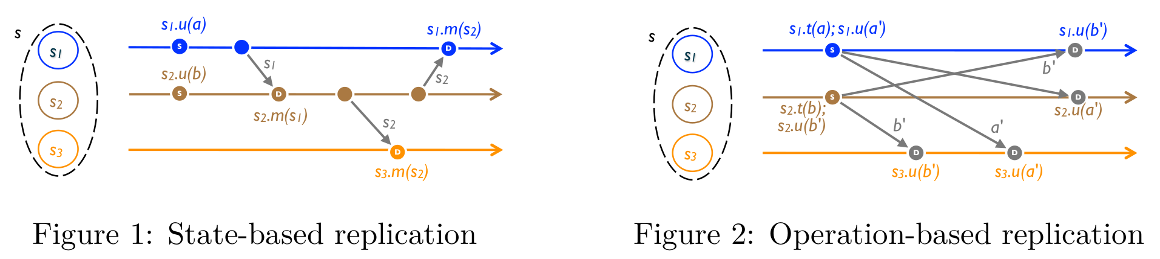
Types of Replication
Basically two ways to analyze the replica^{ref} objects:
State-based replication
State transfer systems limit an operation to overwrite the entire object.
Operation-based replication
Operation transfer system describes operation more semantically.
Any SEC state-based object can be emulated by a SEC op-based object of a corresponding interface and vice versa.-(Equivalence)

Slide 14

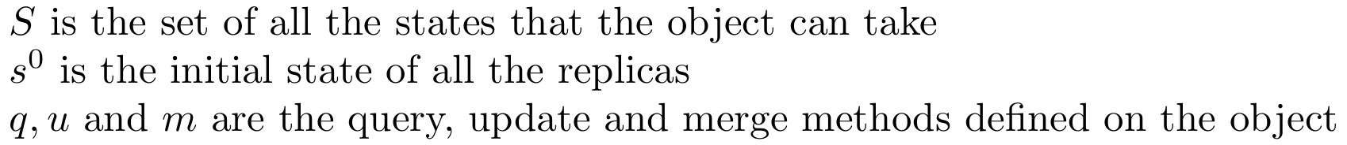
State-based Objects
We analyze replicated objects in the state-based style.
Executing an update modifies the state of a single replica.
Every replica occasionally sends its local state to some other replica, which merges the state thus received into its own state.
An object at any instance is defined as a tuple

Slide 15
State-based Objects cont.
Query method(q): Client may read the state of the object from any replica.
Update method(u): Client may modify the state of any single replica.
Merge method(m): serves to merge the state from a remote replica.
Infinitely often, the replica at p_{i} sends its current state to p_{j}; replica p_{j} merges the received state into its local state by executing method m.

Slide 16
System Model cont.
Initial payload state
x1
Updates happen on a single replica
Query: client may read the state of the object
3 replicas with initial payload states as s⁰
Merge the state from a remote replica
x2
x3
Time

Slide 17
Some more notations:
Method execution at some replica are numbered.
The k^{th} method execution at replica i will be noted f_{i}^{k}(a), where f may be either q,u or m method, and a denotes the argument.
The states of a replica are numbered sequentially incrementing with each method execution. The replica i has initial state s_{i}⁰ = s⁰.
Before its k^{th} execution of a method it has state s_{i}^{k-1}, and s_{i}^{k} afterwards.
s_{i}^{k-1} . f_{i}^{k}(a) = s_{i}^{k}
We define state equivalence s ≡ s’ if all queries return the same result for s and s’

Slide 18
SC, EC and SEC

Slide 19
Approaches for consistency:
Strong Consistency (Sequential Consistency).
Total Order on all updates.
Does not scale well.
Eventual Consistency.

Slide 20
Eventual Consistency
Eventual Delivery
Eventual delivery of an update to all replicas.
Convergence
Correct replicas that have delivered the same update eventually reach equivalent state
Termination

Slide 21
Example for EC
We have a distributed editing software running on ‘n’ machines.
At Replica 1: PoDS is great.
At Replica 2: PoDS is good.
Conflict!
How will they merge?

Slide 22
Our approach: Strong Eventual Consistency
And object has to be Eventually Consistent and follows:
Strong Convergence: Correct replicas that have *been* delivered the same set of updates have equivalent state.
How do we do that?

Slide 23
Example for SEC
We have a distributed software with ‘n’ replicas.
At Replica R1: update(x1)
At Replica R2: update(x2)
Replica R1 sends its state to R2.

Slide 24
Topics Covered:
Causal history with example.
Happen before relation.
Basics of discrete mathematics.
Monotonic semilattice object.

Slide 25
Causal History with examples.
Causal history is a set which is maintained by every replica. It will contains all set of updates done by client on that replica (directly or indirectly).
Notation for causal history:
C_{i}^{k} represents causal history of replica 𝚒, after k^{th} method execution.
Initially all the replicas causal history will be empty.
C_{i}⁰ = 𝝓, for all 𝚒

Slide 26
Possible changes to causal history, when any of three different methods executed on the replica:
A Query method 𝙦 : It is a read only method, causal history does not change with method execution, i.e., C_{i}^{k} = C_{i}^{k-1}.
An Update method 𝚞 (noted f_{i}^{k} (a)): Here f represents the specific operation and a represents the argument. It gets added to the causal history, i.e., C_{i}^{k} = C_{i}^{k-1} ⋃ {f_{i}^{k} (a)}.
A Merge method m (noted m_{i}^{k} (s_{i’}^{k’} )) : Causal histories of the current state and merging state i.e., s_{i’} are unioned together. C_{i}^{k} = C_{i}^{k-1} ⋃ C_{i’}^{k’}.

Slide 27
Significance of Causal history
Causal history is a formal reasoning device.
Causal history is not needed in a concrete implementation.
Causal history gives the information about all the updates done by the client on a replica.

Slide 28
Example of Causal History :
Payload value is integer, merge operation will be performed by taking max of states. Update operation can be performed to change the value of state.
x₁ := 1, C₁ ¹ = {u(1)}
C₁ ² = {u(1),u(4)}
0
m
x₂ := 4, C₂ ¹ = {u(4)}
0
0
m
C₃ ¹ = {u(4)}

Slide 29
Happens-before relation
An update is delivered at some replica, when it is included in the causal history of that replica.
An update u is happened before u’ (u → u’), iff u is delivered at the node where u’ executes before u’ is executes.
Since, u delivered before u’. This means that the causal history of u must be the subset of the causal history of u’
It is also possible that at the same time on a replica, two or more updates came. They are concurrent (u ∥ u’), when neither happened before the other i.e., (u ⥇ u’ ∧ u’ ⥇ u )

Slide 30
Semilattice
A poset (S,≤) is a join semilattice, iff ∀ x,y ∈ S, x ⊔ y (Least upper bound of {x,y} ) exists.
LUB/supremum/Join:
m = x ⊔ y is a Least upper bound of {x,y} under ≤ , then the following implication must hold true:
iff ∀ m’ , x ≤ m’ ⋀ y ≤ m’ ⟹ x ≤ m ⋀ y ≤ m ⋀ m ≤ m’

Slide 31
Properties that Least Upper Bound follows(⊔)
Commutative : x ⊔ y = y ⊔ x
Associative : x ⊔ ( y ⊔ z ) = (x ⊔ y) ⊔ z
Idempotent : x ⊔ x = x
Example of Semilattice:
(int,≤): x ⊔ y = max(x,y)

Slide 32
Example of Semi lattice(Hasse diagram)
b
a ∨ b does not exists
Not Join Semi lattice Join Semi lattice
e
c
d
a
c
d
e
a
b
f

Slide 33
Monotonic Semilattice object
A state based object, equipped with partial order ≤, can be represented as: (S, ≤, s⁰, q, u, m)
If the state based object has the following properties, then it is called as monotonic semilattice object:
Set S of payload values forms a semilattice ordered by ≤.
Merging state s with remote state s’ computes the LUB of the two states, i.e., s . m(s’) = s ⊔ s’
State is monotonically non decreasing across updates, i.e., s ≤ s . u, for any update u

Slide 34
Example of monotonic semilattice:
The following monotonic semilattice object example has integer payload and the merge is max operation.
All subsequent updates on a replica are in monotonically non decreasing order.
x₁ := 1
max
0
4
m
max
0
x₂ := 4
m
4
max
max
0
m
4
m

Slide 35
Recap
Sequential consistency vs Eventual consistency vs Strong eventual consistency(SEC)
System model
Set of non-byzantine processes interconnected by an asynchronous network.
State-based object
Defined as a tuple (S, s⁰, q, u, m)
State-based replication
Causal history
Set of updates
Represented as C_{i}^{k} , where i indicates replica and k indicates the kth method execution.
Monotonic semilattice object - (S, ≤, s⁰, q, u, m)
(S,≤) is a join semilattice iff ∀ x,y ∈ S, x ⊔ y (Least upper bound of {x,y} ) exists.
Merging state s with remote state s’ computes the LUB of the two states
State is monotonically non-decreasing across updates.

Slide 36
Outline
State-based Convergent Replicated Data type (CvRDT) Theorem
Example CRDTs
G-counter
PN-counter
Non-negative counter
Last writer wins (LWW) register
Comparison of BASE, CALM and CRDT

Slide 37
State based Convergent CRDT

Slide 38
In state based CRDT approach replicas share their state objects to propagate the updates
Convergent CRDT means the states of replicas converge to a common state after exchanging the updates .
Convergent CRDT is represented as CvRDT

Slide 39
We have seen what Strong Eventual Consistency Means .
Question : Can we guarantee that SEC will be achieved ?

Slide 40
CvRDT Theorem :
Assuming eventual delivery and termination , any state based object
that satisfies the motonic semilattice property is SEC

Slide 41
Assumptions :
Eventual Delivery
Updates transmitted by replica will reach every other replica
Termination
Operations executing at replica will not contain infinite loop or recursion
Every operation is enabled
Operation is enabled if precondition is satisfied

Slide 42
Example
x1
{u₁,u₂}
x2
{v₁,v₂}
x3
{z₁,z₂}

Slide 43
Example cont.
We are considering only a subset of updates
We say states converged successfully when causal histories of all replicas should contain
{u₁,u₂,v₁,v₂,z₁,z₂}

Slide 44
Example cont.
v₁ happens before v₂
u₁ happens before v₂
v₁ happens before z₁
u₁ and z₁ are concurrent
v₂ and z₁ are concurrent
u₁ and v₁ are concurrent
C₁={u₁,v₁ }
C₁={u₁,v₁,z₁ }
C₁={u₁ }
C₁={u₁,v₁,z₁,u₂ }
C₁={u₁,v₁,z₁,v₂,z₂,u₂ }
C₁={ }
merge
merge
u₂
merge
x1
u₁
C₂={ }
C₂={ v₁}
C₂={ v₁,u₁,v₂}
C₂={ v₁,u₁}
C₂={ v₁,u₁,v_{2,},z₁,u₂,z₂}
v₁
v₂
x2
merge
merge
C₃={ }
C₃={ v₁,z₁,u₁,v₂}
C₃={ v₁,z₁,u₁,v₂,z₂,u₂}
z₁
z₂
x3
merge
merge
merge
C₃={ v₁,z₁}
C₃={ v₁,z₁,u₁,v₂,z₂}
C₃={ v₁}

Slide 45
We can see that states have becomes equivalent
C1 ≡ C2 ≡ C3
Replicas change state only during update or merge operations
Updates are either added in causal history or it remains same but updates are never deleted

Slide 46
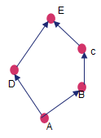
Replicas transmit and merge infinitely often
Replicas converge to the LUB of most recent updates
We have assumed that it satisfies a monotonic semilattice , transitivity of LUB hold
And once similar updates have been delivered states become equivalent
A⊔B = B
B⊔C=C
A⊔C=C

Slide 47
Example CRDT

Slide 48
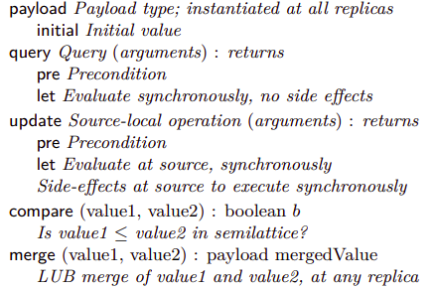
State-based object specification

Slide 49
State-based object specification

Slide 50
State-based object specification

Slide 51
State-based object specification

Slide 52
State-based object specification

Slide 53
Counters
What’s the need?
Suppose the payload was a single integer, update performs increment by 1 and merge computes max. This data type is a CvRDT as its states form a monotonic semilattice.
Consider two replicas, with the same initial state of 0; at each one, a client originates increment.They converge to 1 instead of the expected 2.

Slide 54
Counters
0
x
x₁
0
x₂
Update : Increment the integer in it’s local replica
Merge : It will update the integer with the maximum of both integers

Slide 55
Counters
0
u(x₁)
1
x
x₁
0
x₂
Update : Increment the integer in it’s local replica
Merge : It will update the integer with the maximum of both integers

Slide 56
Counters
0
u(x₁)
1
x
x₁
0
u(x₁)
1
x₂
Update : Increment the integer in it’s local replica
Merge : It will update the integer with the maximum of both integers

Slide 57
Counters
0
u(x₁)
1
x
x₁
0
u(x₁)
1
m(x₂,x₁)
1
x₂
Update : Increment the integer in it’s local replica
Merge : It will update the integer with the maximum of both integers

Slide 58
Counters
0
u(x₁)
1
m(x₁,x₂)
1
1
1
x
x₁
0
u(x₁)
1
m(x₂,x₁)
1
x₂
Update : Increment the integer in it’s local replica
Merge : It will update the integer with the maximum of both integers

Slide 59
Counters
0
u(x₁)
1
m(x₁,x₂)
1
x
x₁
2
expected
0
u(x₁)
1
m(x₂,x₁)
1
x₂
Update : Increment the integer in it’s local replica
Merge : It will update the integer with the maximum of both integers

Slide 60
Vector Clock
A vector clock is a data structure used for determining the partial ordering of events in a distributed system. A vector clock of a system of N processes is an vector of N logical clocks, one clock per process.
VC_{i} is denoted as the vector clock maintained by process i.
Initially all clocks are 0.
When a process experiences an internal event, VC_{i}[i] = VC_{i}[i] + 1
When a process sends a message, it piggybacks a copy of its own vector.
When a process receives a message, VC_{i}[k] = max( VC_{i}[k], VC_{j}[k] ) , ∀ k

Slide 61
Types of Counter
Increment-only Counter (G-Counter)
PN-Counter
Non-negative Counter

Slide 62
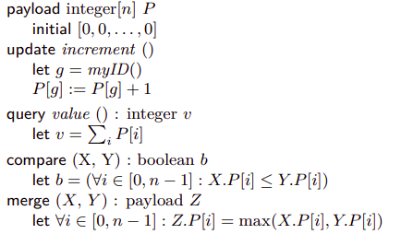
Increment-only Counter (G-Counter)
⊲ One entry per replica
⊲ g: source replica

Slide 63
Increment-only Counter (G-Counter)
⊲ One entry per replica
⊲ g: source replica

Slide 64
Increment-only Counter (G-Counter)
⊲ One entry per replica
⊲ g: source replica

Slide 65
Increment-only Counter (G-Counter)
⊲ One entry per replica
⊲ g: source replica

Slide 66
Increment-only Counter (G-Counter)
⊲ One entry per replica
⊲ g: source replica

Slide 67
Increment-only Counter (G-Counter)
Assumption
Payload does not overflow
Set of replicas is well-known
Applications
Count the number of clicks on a link in a P2P-replicated web page
A P2P “I Like It/I Don’t Like It” poll

Slide 68
P-N Counters

Slide 69
PN-Counters
Counters which can be incremented and decremented as well
Use Case : Counting number of logged in or active users in distributed applications/games
How to implement this?
Can’t we use the G-Counter itself and add a new decrement operation?

Slide 70

PN-Counters : Why G-Counter can’t be used directly?
Why can’t we just add a decrement operation in the G-Counter specification?
Because of following reasons :
Monotonic Semilattice Property violated by decrement operation
Monotonicity Violated!
Prev decrement is lost!
0|0
Incr
1|0
Decr
0|0
Merge
1|1
R1
0
1
0
2
0|0
Incr
0|1
1|1
R2
1
0
2
Merge

Slide 71
Solution : Use two G-Counters
Combine two G-Counters (P, N) - Use one for counting increments, other for decrements
Operations defined as follows :
Increment : Increment the replica’s counter in the P counter (vector)
Decrement : Increment the replica’s counter in the N counter (vector)
Query : Return sum(value of P counter) - sum(value of N counter)
Merge

Slide 72
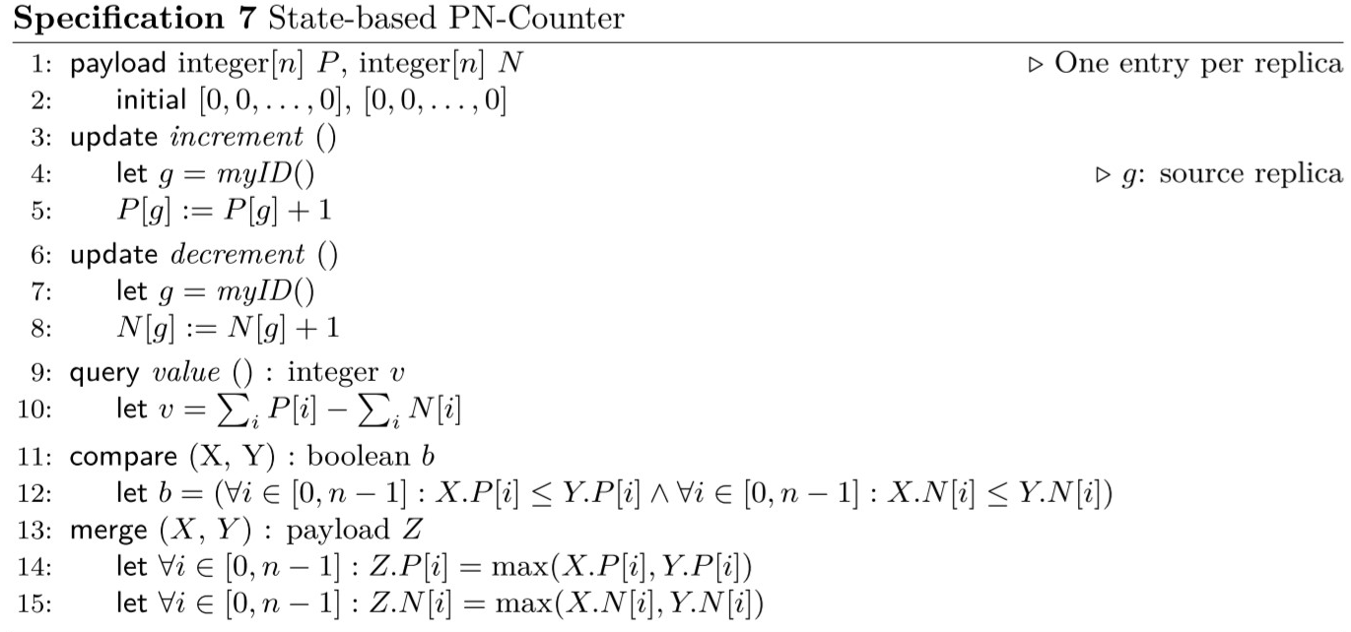
P-N Counter Specification

Slide 73
P-N Counter Demo
Monotonicity obeyed!
Prev decrement is not lost!
P: 0|0
N: 0|0
P: 1|0
N: 0|0
P: 1|0
N: 1|0
P: 1|1
N: 1|0
R1
Incr
Decr
Merge
0
1
0
1
P: 0|0
N: 0|0
P: 0|1
N: 0|0
P: 1|1
N: 0|0
P: 1|1
N: 1|0
Incr
R2
0
1
2
1
Merge
Merge

Slide 74
Non-Negative Counters
Some applications require a counter that is non-negative
Can we use P-N counter and just disallow decrements when counter value is zero?
No, because the invariant is global and local value may not be consistent with the actual global value at the moment
Counter became negative!
P: 0|0
N: 0|0
P: 1|0
N: 0|0
P: 1|0
N: 1|0
P: 1|0
N: 1|1
R1
Incr
Decr
Merge
0
1
0
-1
P: 0|0
N: 0|0
P: 1|0
N: 0|0
P: 1|0
N: 0|1
Decr
R2
0
1
0
Merge

Slide 75
Non-Negative Counters
Method 1
Enforce a local invariant that implies the global invariant
E.g. A rule that any replica may not originate more decrements than it originated increments (i.e., ∀g : P[g] −N[g] ≥ 0)
Very strong restriction - Although a decrement could be possible globally, a replica may skip it as the local invariant doesn’t permit it
Method 2

Slide 76
Registers

Slide 77
Registers
A Register is a memory cell storing an object.
It supports two operations: assign and value

Slide 78
Register in a Distributed System
Reg = ⊥
1
Reg = ⊥
2

Slide 79
Register in a Distributed Systems
C₁⁰ = { }
Reg = ⊥
1
Reg = ⊥
2
C₂⁰ = { }

Slide 80
Register in a Distributed System
C₁⁰ = { }
U₁=assign(B)
Reg = ⊥
1
Reg = ⊥
2
C₂⁰ = { }

Slide 81
Register in a Distributed Systems
C₁⁰ = { }
U₁=assign(B)
C₁¹ = {U₁}
Reg = ⊥
1
Reg = ⊥
2
C₂⁰ = { }

Slide 82
Register in a Distributed System
C₁⁰ = { }
U₁=assign(B)
C₁¹ = {U₁}
Reg = ⊥
Reg = B
1
Reg = ⊥
2
C₂⁰ = { }

Slide 83
Register in a Distributed System
C₁⁰ = { }
U₁=assign(B)
C₁¹ = {U₁}
U₂=assign(A)
Reg = ⊥
Reg = B
1
Reg = ⊥
2
C₂⁰ = { }

Slide 84
Register in a Distributed System
C₁⁰ = { }
U₁=assign(B)
C₁¹ = {U₁}
U₂=assign(A)
C₁² = {U_{1,} U₂}
Reg = ⊥
Reg = B
1
Reg = ⊥
2
C₂⁰ = { }

Slide 85
Register in a Distributed System
C₁⁰ = { }
U₁=assign(B)
C₁¹ = {U₁}
U₂=assign(A)
C₁² = {U_{1,} U₂}
Reg = ⊥
Reg = B
1
U₁ happens-before U₂ since C₁¹ ⊂ C₁²
Reg = ⊥
2
C₂⁰ = { }

Slide 86
Register in a Distributed System
C₁⁰ = { }
U₁=assign(B)
C₁¹ = {U₁}
U₂=assign(A)
C₁² = {U_{1,} U₂}
Reg = ⊥
Reg = B
Reg = A
1
Reg = ⊥
2
C₂⁰ = { }

Slide 87
Register in a Distributed System
C₁⁰ = { }
U₁=assign(B)
C₁¹ = {U₁}
U₂=assign(A)
C₁² = {U_{1,} U₂}
Reg = ⊥
Reg = B
Reg = A
1
Reg = ⊥
2
C₂⁰ = { }
U₃ =assign(C)

Slide 88
Register in a Distributed System
C₁⁰ = { }
U₁=assign(B)
C₁¹ = {U₁}
U₂=assign(A)
C₁² = {U_{1,} U₂}
Reg = ⊥
Reg = B
Reg = A
1
Reg = ⊥
2
C₂⁰ = { }
C₂¹ = {U₃}
U₃ =assign(C)
Reg = C

Slide 89
Register in a Distributed System
C₁⁰ = { }
U₁=assign(B)
C₁¹ = {U₁}
U₂=assign(A)
C₁² = {U_{1,} U₂}
Reg = ⊥
Reg = B
Reg = A
1
Reg = ⊥
2
C₂⁰ = { }
C₂¹ = {U₃}
U₃ =assign(C)
Reg = C

Slide 90
Register in a Distributed System
C₁⁰ = { }
U₁=assign(B)
C₁¹ = {U₁}
U₂=assign(A)
C₁² = {U_{1,} U₂}
Reg = ⊥
Reg = B
Reg = A
1
Reg = ⊥
2
C₂¹ = {U₃}
What is the happens-before relation between U₂ and U₃ ?
C₂⁰ = { }
U₃ =assign(C)
Reg = C

Slide 91
Register in a Distributed System
C₁⁰ = { }
U₁=assign(B)
C₁¹ = {U₁}
U₂=assign(A)
C₁² = {U_{1,} U₂}
Reg = ⊥
Reg = B
Reg = A
1
Reg = ⊥
2
C₂¹ = {U₃}
What is the happens-before relation between U₂ and U₃ ?
C₂⁰ = { }
We cannot say.
C₂¹ is not subset of C₁² and vice-versa
U₃ =assign(C)
Reg = C

Slide 92
Register in a Distributed System
C₁⁰ = { }
U₁=assign(B)
C₁¹ = {U₁}
U₂=assign(A)
C₁² = {U_{1,} U₂}
Reg = ⊥
Reg = B
Reg = A
1
Reg = ⊥
2
C₂¹ = {U₃}
Hence, U₂ and U₃ are concurrent updates and do not commute.
Then, how to decide the last update?
C₂⁰ = { }
U₃ =assign(C)
Reg = C

Slide 93
LWW - Register
It associates a timestamp with each updates to create a total order of assignments.
Timestamps should be:
Unique
Totally ordered

Slide 94
No, because there are many possible total orderings between the updates
And the semantics of LWW-registers says that the bigger timestamp wins.
Reg-R = ⏊,0
assign(B)
R
Reg-R = B,1
Now what do you think the timestamp should be ?? Should it be greater than 1??
Reg-S = ⏊,0
S
Reg-S = B,1
assign(C)

Slide 95
LWW - Register
The timestamps beings consistent with causal order means that if there are two updates u and v and u is happened before v then the timestamp of u should be lower that timestamp of v.

Slide 96
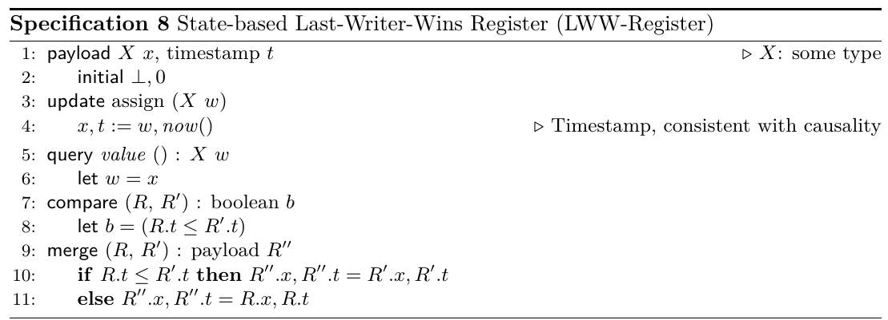

Slide 97
( Register value , Timestamp )
x1 = (⏊,0)
x
In replica 2, a new timestamp is generated,
which should be consistent with the causal updates.
now() generate timestamp = 1, which is consistent with the causal history. Verify it.
So, new state at replica 2 becomes x2 = (2 , 1)
And causal history is updated. U₁ is added to the causal history of replica 2.
x1
x2 = (⏊,0)
U₁ = assign(2)
x2
C₂ = {U₁}
x2 = (2,1)
x3
x3 = (⏊,0)

Slide 98
x
x1 = (⏊,0)
x1
x2 = (2,1)
U₁ = assign(2)
C₂ = {U₁}
x2
x3 = (3,2)
x3
U₂ = assign(3)
C₃ = {U₂}
Timestamp generated is = 2
x3 = (⏊,0)

Slide 99
Timestamp generated is = 3
x1 = (⏊,0)
x1 = (1,3)
U₃ = assign(1)
x
C₁ = {U₃}
x1
U₁ = assign(2)
C₂ = {U₁}
x2
x2 = (2,1)
x3
U₂ = assign(3)
C₃ = {U₂}
x3 = (3,2)

Slide 100
Timestamp generated should be greater than 3.
now( ) generates timestamp = 4
x
U₃ = assign(1)
C₁ = {U₃}
U₄ = assign(4)
x1 = (4,4)
x1 = (1,3)
x1
C₁ := {U₃} U {U₄}
U₁ = assign(2)
x2 = (2,1)
C₂ = {U₁}
x2
x3
U₂ = assign(3)
C₃ = {U₂}
x3 = (3,2)

Slide 101
x1 = (4,4)
x
U₃ = assign(1)
C₁ = {U₃}
U₄ = assign(4)
U₄ = assign(4)
C₁ = {U₃ , U₄}
x1
U₁ = assign(2)
C₂ = {U₁}
x2 = (2,1)
x2
U₂ = assign(3)
C₃ = {U₂}
x3 = (4,4)
C₃ = {U₂, U₃ , U₄}
x3
x3 = (3,2)
In merge, payload with largest timestamp wins.
Causal history is updated.

Slide 102
U₅ happens after U₂,U₃,U₄
So, what timestamp should be generated??
now() generates timestamp = 5
Causal history is also updated.
x
x1 = (4,4)
U₃ = assign(1)
C₁ = {U₃}
U₄ = assign(4)
C₁ = {U₃ , U₄}
x1
U₁ = assign(2)
C₂ = {U₁}
x2 = (2,1)
x2
U₂ = assign(3)
C₃ = {U₂}
C₃ = {U₂,U₃,U₄} U {U₅}
x3
x3 = (4,4)
x3 = (7,5)
C₃ = {U₂, U₃ , U₄}
U₅ = assign(7)

Slide 103
In replica 2, merge happens.
Here the payload with the largest timestamp will win.
Causal History will be Unioned.
x1 = (4,4)
U₃ = assign(1)
C₁ = {U₃}
U₄ = assign(4)
C₁ = {U₃ , U₄}
x
x1
x2 = (7,5)
U₁ = assign(2)
C₂ = {U₁}
x2 = (2,1)
C₂ = {U₁} U {U₂,U₃,U₄,U₅}
x2
U₂ = assign(3)
C₃ = {U₂}
x3
x3 = (7,5)
C₃ = {U₂ , U₃ , U₄}
U₅ = assign(7)
C₃ = {U₂,U₃,U₄, U₅}

Slide 104
Some Points About the LWW - Registers
LWW - Registers require the causal history to be transferred explicitly to the replicas because to calculate the timestamps the replica will need the causal history.
Timestamps also can be implemented by using per replica vector clocks and “Mac Addresses” concatenated with the vector clocks of each replica.

Slide 105
Discussion About Implementing TimeStamp
Paper suggests - We can Have a Per-Replica Counter Concatenated with MAC Address of the Replica.
But Can we establish Total Order With this Approach??
Lets have a G-Counter per Replica …
For Example there are 2 replicas . So, Each will maintain Counter (0,0)
1st Replica will update 1st entry of the Counter.

Slide 106
G-Counters Establish A Partial Order. We are Clear On it.
NOW How do we make it total order ???
We can use following Approach:

Slide 107
Sequential Consistency & SEC

Slide 108
Is a sequentially-consistent object also a SEC object?
Is a SEC object also a sequentially-consistent object?

Slide 109
Is a sequentially-consistent object also a SEC object?

Slide 110
Is a sequentially-consistent object also a SEC object?
NO. Why?

Slide 111
Is a sequentially-consistent object also a SEC object?
NO. Why?
Sequential consistency requires consensus.
In absence of crashes, a SC object is a SEC object.
In general case, SC requires at least n/2 active replicas to achieve consensus while SEC requires only 1 active replica.

Slide 112
2. Is a SEC object also a sequentially-consistent object?

Slide 113
2. Is a SEC object also a sequentially-consistent object?
Methods executed at a single replica follow sequential order.
State updates from other replicas can arrive concurrently.
Define concurrency:
Updates u₁ and u₂ are concurrent if we cannot establish happens-before relationship between them.
Thus, a CRDT must specify both sequential behavior and concurrent behavior and concurrent behavior must satisfy the strong convergence property.

Slide 114
Example CRDT: Set
Two operations are defined: add(element), remove(element)
Semantics for sequential execution:
Last update wins .
Execution sequence 1: ( add(e), remove (e) ) leads to S = { }
Execution sequence 2: ( remove(e), add(e) ) leads to S = {e}
Semantics for concurrent execution:
Can we say which is update is last?

Slide 115
Semantic for concurrent updates
Operation on different elements:
Execution sequence 1: ( add(e) || remove(e’) ) leads to S = {e}
Operation on same element:
Execution sequence 2: ( add(e) || remove(e) ) leads to S = ?
How to handle such concurrent updates?
Choose any semantic according to application.
E.g.: add wins, remove wins, update from highest IP address wins, etc.
All these alternatives satisfy the strong convergence condition. Why?

Slide 116
Example
Consider add-win alternative: after ( add(e) || remove(e) ), S = {e}
Two sets S and D are used to store present and deleted elements respectively.
add(e)
rmv(e’)
R1
S = {e}; D= {e’}
1
2
R2
R3

Slide 117
Example
Consider add-win alternative: after ( add(e) || remove(e) ), S = {e}
add(e)
rmv(e’)
R1
S = {e}; D= {e’}
1
2
R2
add(e’)
rmv(e)
S = {e’}; D= {e}
R3
1
2

Slide 118
Example
Consider add-win alternative: after ( add(e) || remove(e) ), S = {e}
add(e)
rmv(e’)
R1
1
2
U₁ = ( add(e), rmv(e’) )
R2
add(e’)
rmv(e)
R3
1
2

Slide 119
Example
Consider add-win alternative: after ( add(e) || remove(e) ), S = {e}
add(e)
rmv(e’)
R1
1
2
U₁ = ( add(e), rmv(e’) )
R2
U₂ = ( add(e’), rmv(e) )
add(e’)
rmv(e)
R3
1
2

Slide 120
Example
Consider add-win alternative: after ( add(e) || remove(e) ), S = {e}
add(e)
rmv(e’)
R1
Are add(e’) and rmv(e’) concurrent?
1
2
U₁ = ( add(e), rmv(e’) )
R2
U₂ = ( add(e’), rmv(e) )
add(e’)
rmv(e)
R3
1
2

Slide 121
Example
Consider add-win alternative: after ( add(e) || remove(e) ), S = {e}
add(e)
rmv(e’)
R1
Are add(e’) and rmv(e’) concurrent?
C₁² = { add(e), rmv(e’) }
C₃¹ = { add(e’) }
C₁² and C₃¹ are not subset of each other.
1
2
U₁ = ( add(e), rmv(e’) )
R2
U₂ = ( add(e’), rmv(e) )
add(e’)
rmv(e)
R3
1
2

Slide 122
Example
Consider add-win alternative: after ( add(e) || remove(e) ), S = {e}
add(e)
rmv(e’)
R1
1
2
S = {e}, D ={e’}
( add(e), rmv(e’) ) || ( add(e’), rmv(e) )
R2
S = ?,
D = ?
add(e’)
rmv(e)
R3
S = {e’}, D ={e}
1
2

Slide 123
Example
Consider add-win alternative: after ( add(e) || remove(e) ), S = {e}
add(e)
rmv(e’)
R1
1
2
S = {e}, D ={e’}
( add(e), rmv(e’) ) || ( add(e’), rmv(e) )
R2
S = {e, e’},
D ={ }
add(e’)
rmv(e)
R3
S = {e’}, D ={e}
1
2

Slide 124
Example
Consider add-win alternative: after ( add(e) || remove(e) ), S = {e}
add(e)
rmv(e’)
R1
1
2
S = {e}, D ={e’}
( add(e), rmv(e’) ) || ( add(e’), rmv(e) )
Is such state possible in any sequential execution?
R2
S = {e, e’},
D ={ }
add(e’)
rmv(e)
R3
S = {e’}, D ={e}
1
2

Slide 125
Example
Concurrent execution: U₁ = ( add(e), rmv(e’) ) || U₂ = ( add(e’), rmv(e) )
Any sequential execution will have last operation as remove:
Possible states are S = {e} or S = {e’} or S = { }

Slide 126
Example
Concurrent execution: U₁ = ( add(e), rmv(e’) ) || U₂ = ( add(e’), rmv(e) )
Any sequential execution will have last operation as remove:
Possible states are S = {e} or S = {e’} or S = { }
State achieved in concurrent execution will never occur in a sequentially consistent execution.
Thus, there is a SEC object that is not sequentially consistent.

Slide 127
Conclusion: SEC is incomparable with Sequential consistency.

Slide 128
Comparison between
BASE approach and CRDT approach

Slide 129
Consistency Model
BASE
Guarantees eventual consistency
No restrictions on data type of the objects
CRDT
Guarantees strong eventual consistency
state-based object must satisfy the monotonic semilattice property

Slide 130
Conflicts
BASE
Conflicts may arise as each node can update its own copy of an object
Conflict arbitration may require a consensus and a roll-back
CRDT
The design of CRDT gets rid of conflicts
It avoids the complexity of conflict resolution and of roll-back

Slide 131
Availability
BASE
there will be a response to any request.But that response could still be ‘failure’ to obtain the requested data, or the data may be in an inconsistent or changing state
BASE can tolerates up to n/2 simultaneous crashes
CRDT
SEC replica is always available for both reads and writes
An SEC object tolerates up to n − 1 simultaneous crashes.

Slide 132
Latency
BASE
Quorum is not in the critical path but is needed in case of a conflicts
As state of the system is soft, latency of updates is low. However, eventual convergence may have conflicts, convergence latency can be high.
CRDT
No quorum/consensus during updates, so low latency of updates
As design of CRDT ensures no conflicts, latency of convergence is also low

Slide 133
Mathematical Proofs
BASE
Advise on how to implement
No mathematical definitions and proofs
CRDT
Library of concrete data types
Mathematical proofs for correctness guarantee

Slide 134
Comparison between
CRDT approach and CALM approach

Slide 135
Consistency Model
CRDT
Guarantees strong eventual consistency
CALM
logically monotonic distributed code is eventually consistent without any need for coordination protocols
Eventual consistency can be guaranteed in any program by protecting non-monotonic statements with coordination protocols.

Slide 136
Coordination Logic
CRDT
CRDT is defined in such a way that it satisfies the sufficient conditions for convergence
Hence, no coordination logic is required.
CALM
CALM Theorem does not actually tell us how to write consistent, coordination-free distributed systems
The Bloom language can be used by developers to identify non-monotonic “Points of Order” and add coordination logic to enforce the ordering
Coordination protocols - increase latency and
reduce availability in the event of network partitions

Slide 137
CRDT
Library approach. We can use different types of data types which follow CRDT constraints
Structured and flexible
CALM
Implementation with the help of BLOOM language
Developer has to make sure the coordination protocols guarantee consistency

Slide 138
Use Cases of CRDT
Nimbus Note is a collaborative note-taking application that uses CRDT for collaborative editing
SoundCloud uses a CRDT set for streaming, implemented on top of Redis
Teletype for Atom employs CRDTs to enable developers share their workspace with team members and collaborate on code in real time
Pixelboard, a collaborative whiteboarding app, uses CRDTs to allow several people to draw at the same time

Slide 139
Summary and Conclusion
We presented the concept of a CRDT, a replicated data type for which some simple mathematical properties guarantee strong eventual consistency
In the state-based style, the successive states of an object should form a monotonic semilattice, with merge computing a least upper bound
We presented some simple CRDT examples, such as G-Counter, P-N Counter, LWW Register
We compared the CRDT approach with BASE approach and CALM approach

Slide 140
Thank You !

